Slide 1
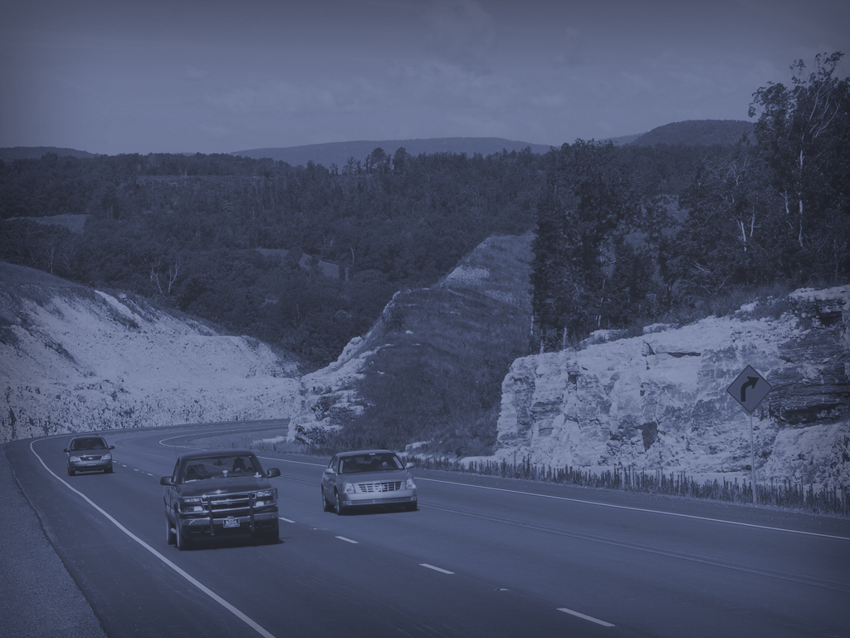
Danny Straessle
Public Information Officer
Transportation Research Committee Engineering Conference
Wednesday, August 14, 2019

Slide 2
Social Media

Slide 3
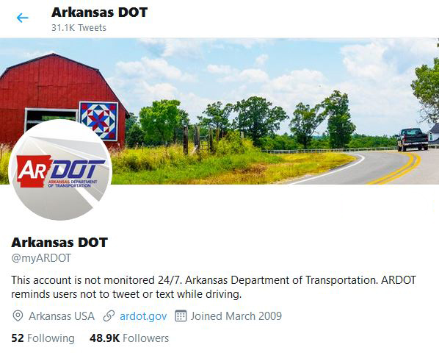
Twitter
Notes:
ARDOT has been on Twitter since March of 2009, so our account turned 10 this year.
We’re not on any other Social Media platforms, as Twitter has the best format for traffic-information; which our primary service to Arkansans.
Each platform has a different style of communication, Twitter is considered a ‘stream of consciousness’ format – which means that it’s best used to find out what it going on at that moment.
CONTINUED ON NEXT PAGE

Slide 4
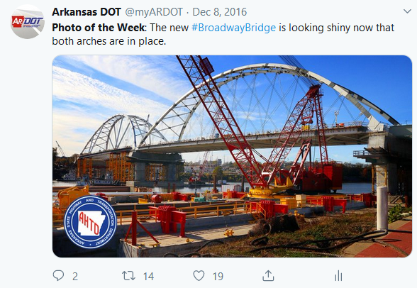
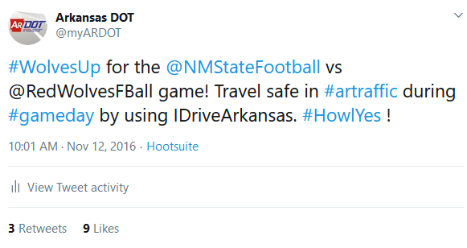
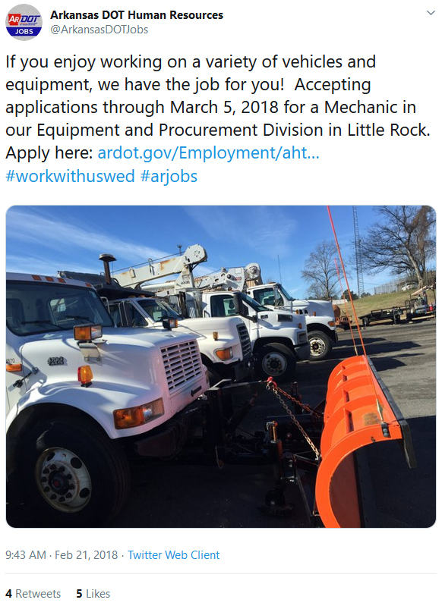
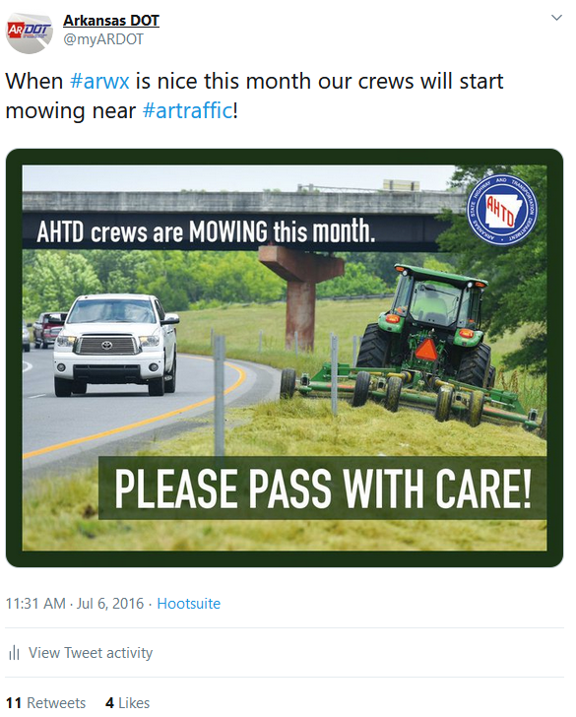
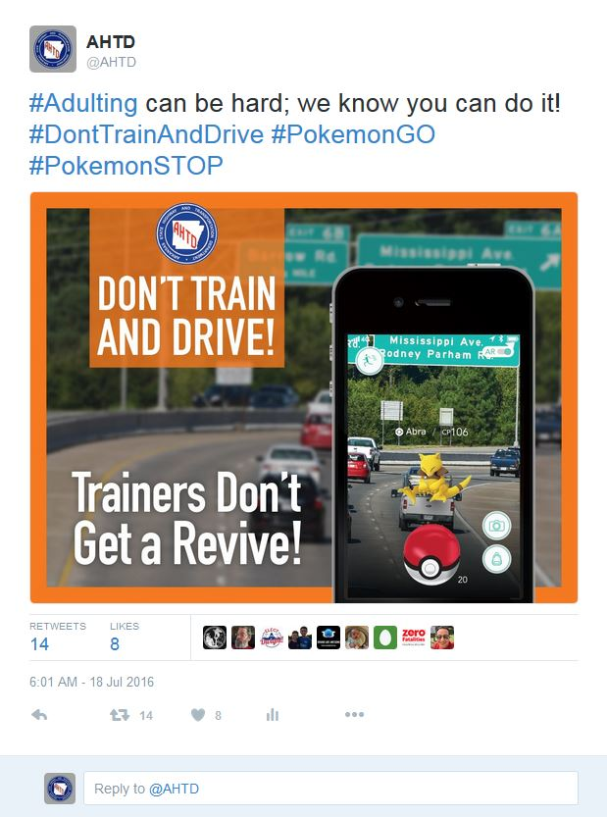
Keeping the Public Engaged
Notes:
It’s really hard to keep the public interested in the “not-sexy” parts of the Transportation world.
Typically, and statistically, people are most active on our Social Media and Websites during a weather event or to complain when there’s a wreck or construction zone that is impacting them directly.
But! Just because it’s difficult, doesn’t mean we don’t try.
Things we have done in the past:
Photo of the Week – very little engagement, discontinued
PSA – Pokemon Go Campaign – lots of engagement at start, dwindled rapidly
Mowing Season – so very little engagement and less proof it helped minimize accidents with those mowing.
#WorkWithUsWed – attempt to highlight personnel who went above and beyond and job openings, again – very little engagement , discontinued
#GameDay – posting about College football games, a lot of tweets and very little engagement unless there was an accident/traffic problem, discontinued
CONTINUED ON NEXT PAGE

Slide 5
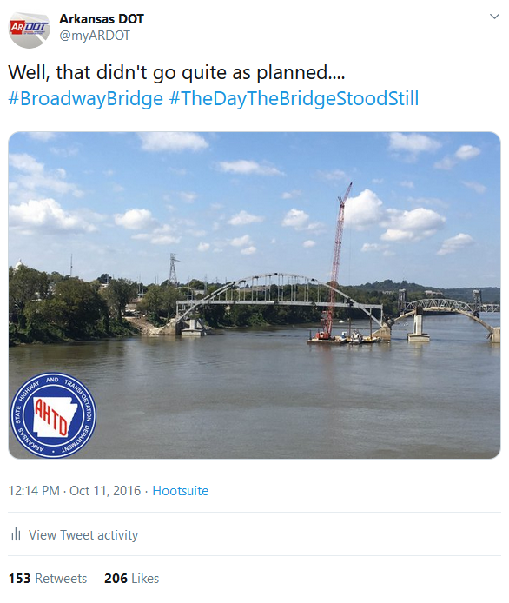
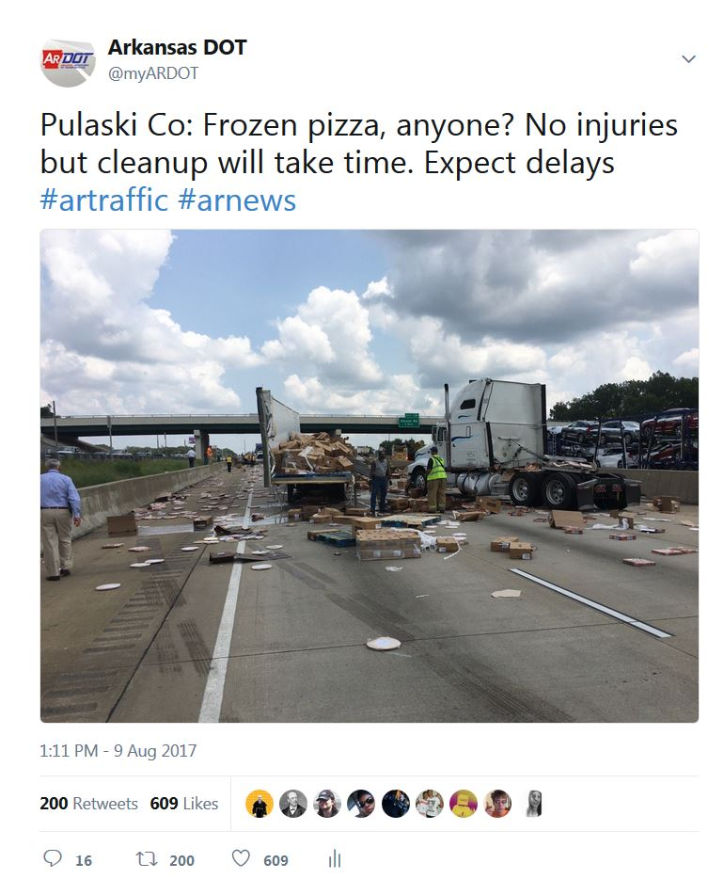
Success Stories
Notes:
The times we have had really high engagement on Twitter is typically when we engaged the public with humor and a willingness to poke fun at ourselves.
Examples:
Broadway Bridge Demolition
Pizza Wreck
CONTINUED ON NEXT PAGE

Slide 6
Strategic Plan

Slide 7
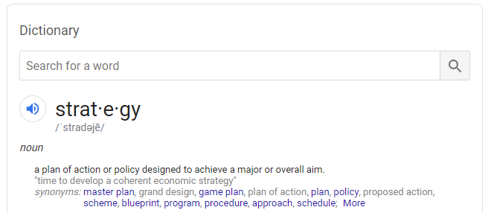
Twitter
Notes:
So the problem with trying to create a strategic plan for public engagement is that….the public is pretty fickle on when it wants to engage with us.
But! That doesn’t mean we don’t aim to take every opportunity that fate throws our way – we just have to be careful.
Jokes aren’t appropriate for all situations (fatalities, really bad accidents, etc).
Jokes at expense of the citizen aren’t as well received from a government entity.
Zero politics allowed.
CONTINUED ON NEXT PAGE

Slide 8
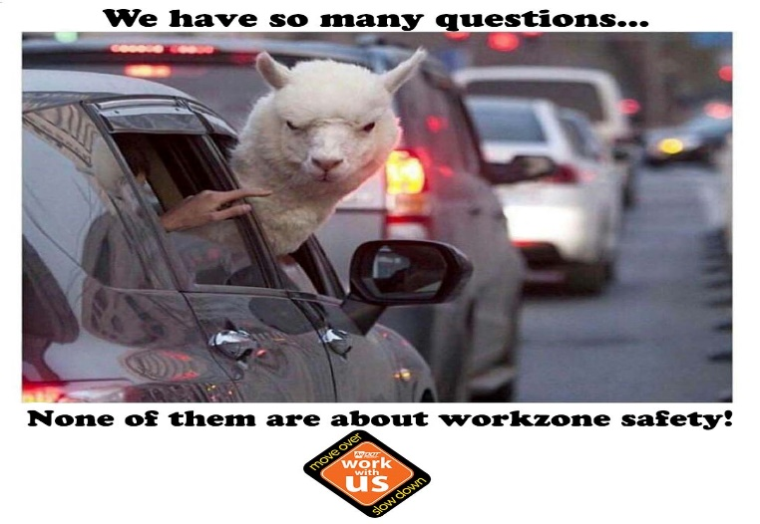
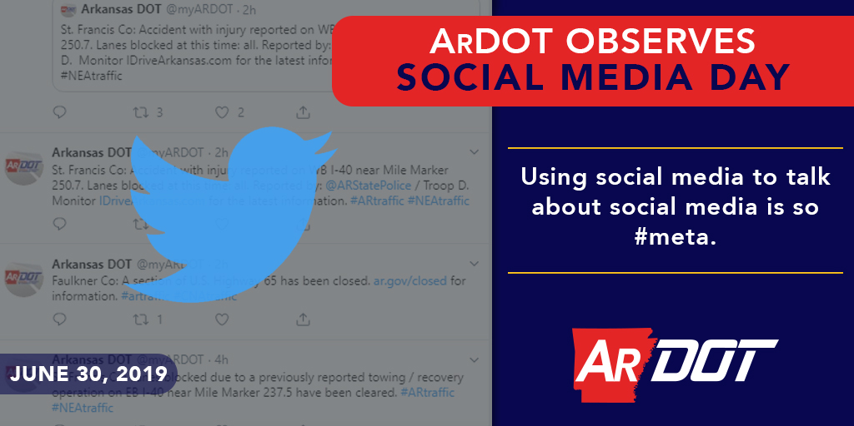
Keeping the Public Engaged
Notes:
But, we’re also pretty stubborn and so we’re still trying to increase our tweets where engagement opportunities exist for the public.
Here’s some stuff we’re doing now or starting soon:
Workzone Awareness Memes – this is aimed at the youngest generations. We’ve only tweeted the one so far but we have dozens planned for the first Monday of every month.
Taking advantage of popular ‘days’ – Emoji and Social Media are two that we’ve done recently.
We’ve gotten mixed results but it’s still too early to call it on these types of posts so we’ll keep going for a while yet.
CONTINUED ON NEXT PAGE

Slide 9
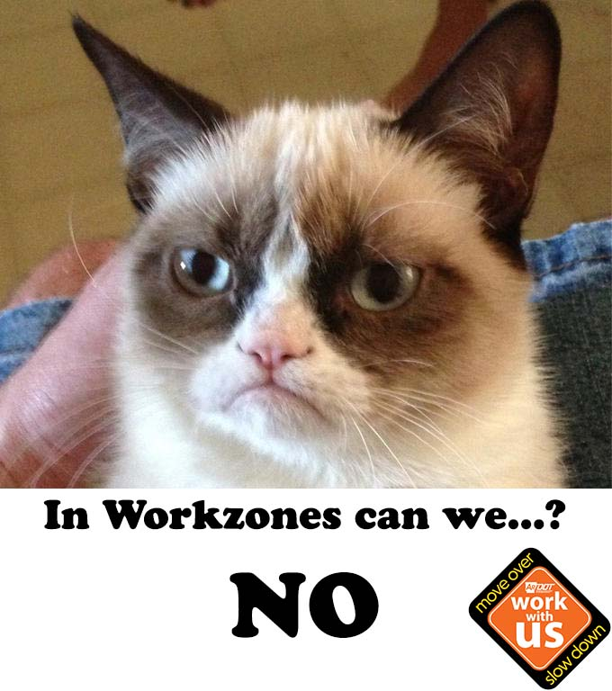
Our Future
Notes:
It’s really hard to predict where Social Media will be in five years, which makes it equally difficult to predict where –our- social media will be.
We want to continue modernizing our use of Social Media. It’s not a place for talking AT the public, it’s a place to talk WITH them. To have conversations.
Social Media, and honestly all public engagement these days, moves really fast and government is always a little slow on adopting the newest things.
CONTINUED ON NEXT PAGE

Slide 10
Questions?

